Slide 1

Guide to Use JIRA
Leader Roles

Slide 2

Overview
Access to JIRA
Create a new issue & getter utilities.
Search for issues and issue filters
Watch an issue
JIRA Dashboard
DAMS Viewer & Logs attaching.

Slide 3
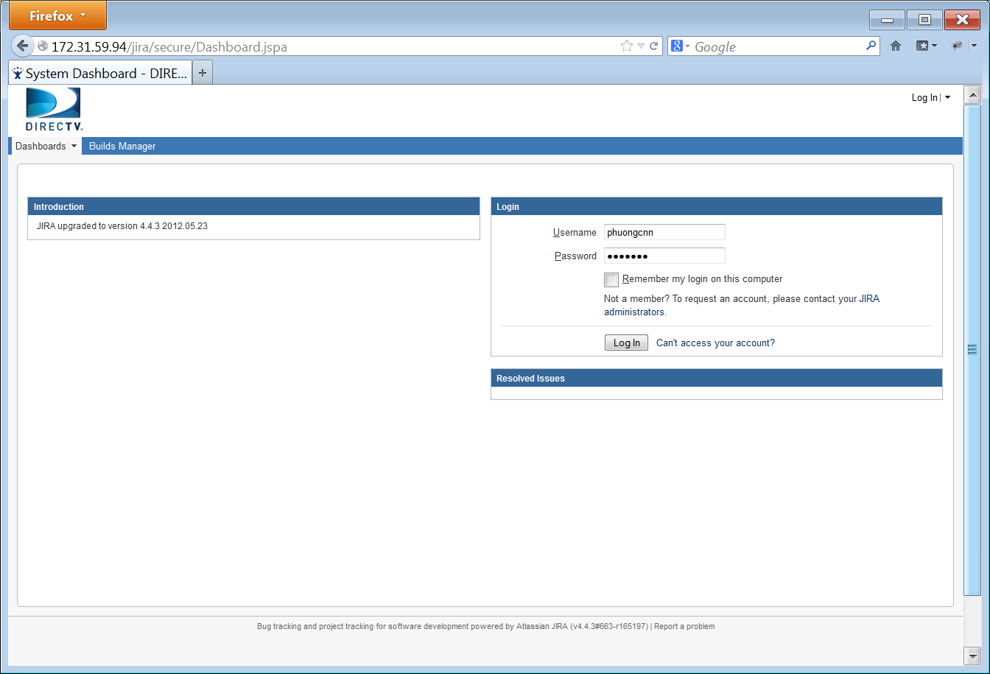
Access to JIRA
Use your web browser to access JIRA at: http://172.31.59.94/jira/
Login with your username and password to continue

Slide 4
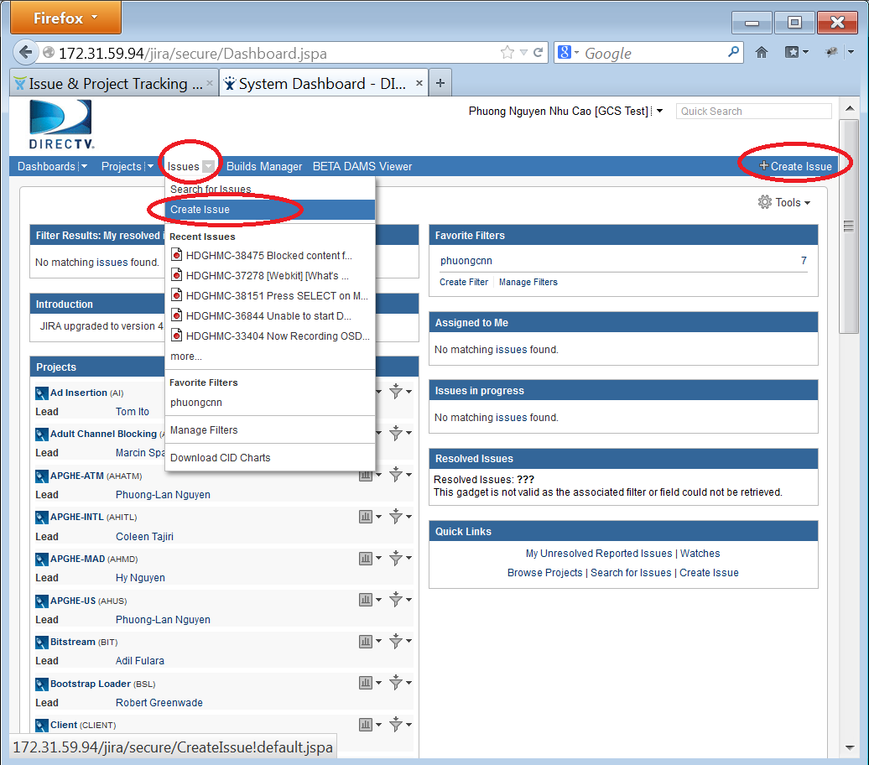
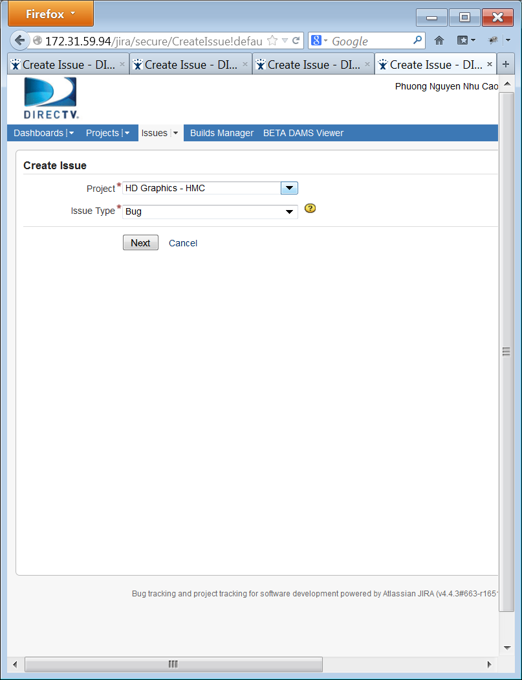
Create new issue
You can quickly create new issue on JIRA by:
Click “Create Issue” link at right corner on navigation bar
Or select “Issue” on menu bar then “Create Issue”
Select the Project and the Issue type then “Next”.

Slide 5
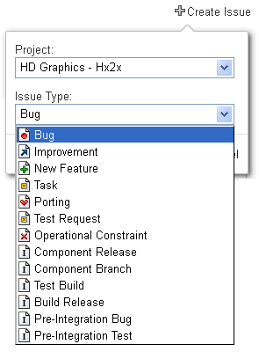
Create new issue - Issue types
Bug
Test Build
Test Request
New Feature

Slide 6
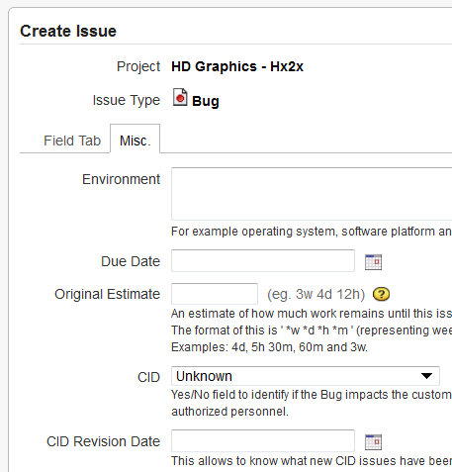

Bug – Review and set severity
When a tester finds a defect on software, he will create an issue type Bug on JIRA. When the bug is created, Test Lead must review it first before assigning it to Development Team.
CID (Customer Impacting Defect): on Misc. tab Test Lead will assign and select CID based on severity of the bug after the ticket is created by testers. The level are SS, P1, P2, P3, P4. The severity of the bug will decide the priority.
Test Lead
Notes:
Both Testers and Developers must familiar with this type of issue.
Testers are the one who usually creating this type of issue.

Slide 7
Bug – review and set severity
P1: A problem that causes total interoperability of the product, one of its major components or presents a serious impairment of functionality, safety, security or serious impact on customer operations and (or) user experience.
Bugs that prevent the box from performing general functionality (Recording, Playback, MRV, trick play)
Failure of critical functionality with no workaround (or the workaround is a reboot)
Data loss or corruption
Billing data or invoice display inconsistencies
Issues blocking testing
Critical functionality discrepancy between requirements and implementation
Critical functionality error handling failures with high occurrence likelihood and resulting in high impact to customers
Security concerns with customer visibility (Parental controls not blocking adult video/content correctly)
Call centers receiving calls about the defect (call volume increases costs to DIRECTV)
Decreases revenue for DIRECTV (customer unable to buy PPV content)
Test Lead

Slide 8
Bug – review and set severity (cont.)
SS: A "show stopper". Essentially, a P1 that Management elevated to SS status.
Example:
Bugs that prevent the box from performing general functionality (Recording, Playback, MRV, trick play, etc.)
Bugs that prevent the user from using an entire functionality.
Major stability issues. Issues that would cause the box to crash in a day.

Slide 9
Bug – review and set severity (cont.)
P2: A problem that results in a major reduction in product quality or functionality without any reasonable workaround and high level of impact on customer operations and (or) user experience.
Examples:
Partially impaired critical functionality with less than desirable workaround (e.g., channel change or exit or retry)
Failure of non-critical functionality with no workaround.
Non critical functionality discrepancy between requirements and implementation.
High customer impact UI discrepancies.
Security concern with no real customer impact

Slide 10
Bug – review and set severity (cont.)
P3: A problem that results in a major reduction in product quality or functionality with reasonable workaround.
Examples:
Impaired non critical functionality with satisfactory workaround
Impaired critical functionality during low occurrence edge cases
High impact spelling errors
Non critical functionality error handling failure.
P4: Partial loss of a function or feature set.
Examples:
Rare occurrence
Low customer impact feature failure
UI layout or low impact spelling errors

Slide 11



Issue types
Bug
Test Build
Test Request
New Feature
Improvement
Developer
Development Lead
Tester
Test Lead

Slide 12
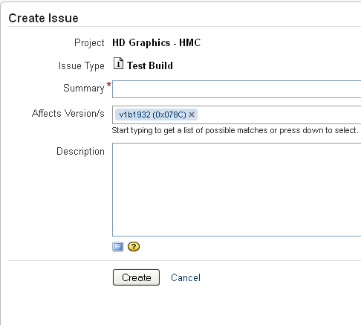
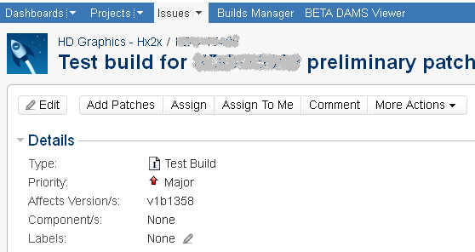

Test Build – Create new issue
Development Lead creates a test build to manage multiple patches.
The fields:
Summary: mention the build test.
Affected Version: should correspond to the most recent CM build ancestor.
Description: provide important notes of the test build.
Some notes:
After creating the Test Build, developer will add patches to the ticket by the “Add Patches” button.
Only Patches in Patch Reviewed and In Testing should be allowed to be added to Test Build. Patch that hasn't been reviewed yet, is not allowed to be added to Test Build.
Development Lead

Slide 13


Test Build Workflow
Create
Open
Submit For Testing
In Testing
Testing completed or
Discard build?
Resubmit for
testing
Testing completed
Discard Build
Test Completed
Submit for next CM build?
No
Resubmit for testing
or Discard build?
yes
Build Ready
Discard Build
Closed
Notes:
1.Development Team creates an issue type Test Build then adds Patches to it. The issue first is in “Open” status.
2.Development Lead clicks on “Submit For Testing” button, the issue status will be changed to “In-Testing”. It will be automatically assigned to Test Team for testing.
3.When the test is done, Test Lead attaches the test results to this issue and changes the status to “Test Completed”. The ticket is automatically assigned to Development Team.
4.If the test is passed, Development Team marks the Test Build as to be included in the next CM build by clicking on the “Submit for next CM Build” and changes the issue to “Build Ready” status.
5.When the requested build is resolved, Development Team will close the issue.
6.If there is problem during testing such as critical bugs that prevent the testing, the build will be discarded, and closed.
7.After testing is completed, if the build is no longer needed, Development Team can also close the issue
8.If the developer wants to fix issues, add issues, or rollback issues, then she/he should click the “Resubmit for Testing” link. A new Test Build ticket will be generated. It will copy all existing links for "based on" and "build contains" to the new issue. The original issue will be closed and linked to the new ones.

Slide 14
Issue types
Bug
Test Build
Test Request
New Feature
Improvement
Developer
Development Lead
Tester
Test Lead

Slide 15
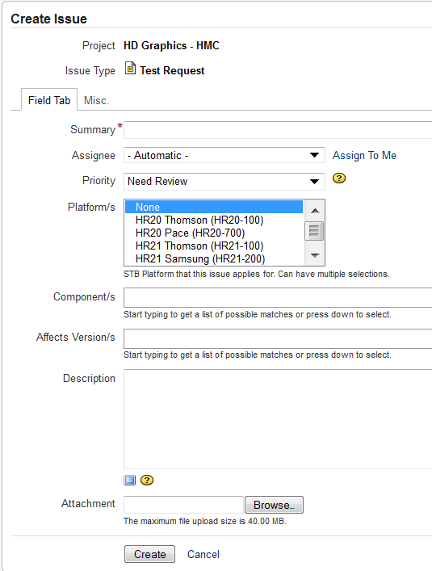
Test Request - Create new issue
* Development Lead creates this task to request Test Team performs test on specific build.
* There are build test request and special test request.
The fields:
Summary: mention the build for build test request, or specify the functions needed testing for special test request.
Assignee: test lead.
Priority: default is “Need Review”.
Platform: list all the needed platforms.
Description must provide: build location, bugs need to be verified (if any), build test request( must indicate the Quick tests and/or Full Regression or Sanity tests, and the major change in the build. For special test request, must provide the test steps)

Slide 16
Test Request Workflow
Request For Testing
In
Progress
Open
Resolve Ticket
Resolve Ticket
Close Ticket
Resolved
Closed
Notes:
1.Develop Lead creates a “Test Request”. Status issue is “Open”.
2.Develop Lead can change the status to “In Progress” then assign the ticket to Test Lead.
3.Test Team performs the test. When the test is done, Test Lead/Tester attaches test results to the ticket and informs Development Team that the test in completed. Test Lead then changes the status to “Resolved”, and assigns the issue to Reporter.
4.The Reporter closes the ticket.
5.After creating the Test Request, Developer Team decide to skip the testing, they can change the status to “Resolve” with resolution “Won’t Fix”.
6.After creating the Test Request, Developer Team can cancel the request by change the status to “Close” with resolution “Won’t Fix” if they decide to discard the change they request to test.

Slide 17
Issue types
Bug
Test Build
Test Request
New Feature
Improvement
Developer
Development Lead
Tester
Test Lead

Slide 18
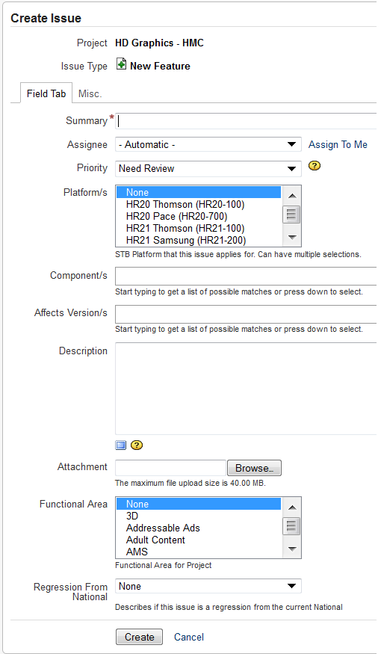
New Feature - Create new issue
When a new feature is implemented, we need a ticket type New Feature. This ticket to track works on the new feature until it is resolved/closed.
A New Feature is normally created by Development Team.
Creating a New Feature is the same as creating a Bug and the meaning of New Feature’s fields is the same as Bug’s.
A New Feature has the same workflow as a Bug.
The New Feature‘s description should provide clearly requirements of the new feature.
A New Feature sometimes has many sub-tasks.
When create a New Feature, the field “Due Date” and “Original Estimate” should also be filled.

Slide 19
Issue types
Bug
Task
Test Build
Test Request
New Feature
Improvement
Developer
Development Lead
Tester
Test Lead

Slide 20

Create New Issue – Improvement
When an existing feature needs to be improved, we create a ticket type Improvement. We use this ticket to track works on the improvement until it is resolved/closed.
Creating an Improvement is the same as creating a Bug and the meaning of Improvement’s fields is the same as Bug’s.
An Improvement has the same workflow as a Bug
An Improvement sometimes has many sub-tasks.

Slide 21
Overview
Access to JIRA
Create a new issue
Search for issues and issue filters
Watch an issue
JIRA Dashboard
DAMS Viewer and logs attaching

Slide 22
Searching Issues
Quick Search
Simple Search
Advanced Search
Issue Filters

Slide 23
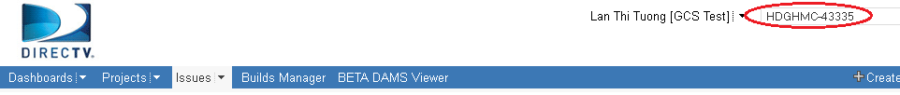
Searching issues – Quick Search
Quick Search supports to go directly to an issue by typing the issue key or run a free-text search.
Jump to an Issue:
The Quick Search box is located at the top right of any JIRA screen. If we type in a correct ID of an issue, we will jump straight to that issue
Ex: type in “HDGHMC-43335” and press Enter, you will be redirected to the JIRA issue with ID = “HDGHMC-43335“

Slide 24
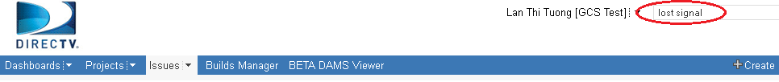
Quick Search – Free text searching
We can search for any word within the issue(s) we are looking for, provided the word is in one of the following fields.
Summary.
Description.
Comments.
Ex: type the string “lost signal” and click Enter, all the issues which contain “lost”, “signal”, “lost signal” are listed on the right hand side of the screen as the search results

Slide 25
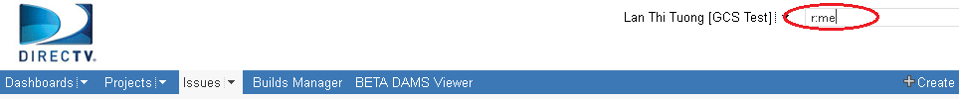
Quick Search – Smart querying
Quick Search also let users perform “smart” searches with minimal typing, called “Smart Querying”. The following table lists some search terms that Quick Search support:
Search Terms | Description | Sample
my | Find issues assigned to me. | my
r: | Find issues reported by you, another user. Using the prefix r: followed by a specific reporter term such as me, username. | r:me – your issues r:lantt – “lantt” issues
<priority> | Find issues with a particular Priority. | Blocker, Low, Critical
<issue type> | Find issues with a particular Issue Type. | Bug, Task, New Feature
Type “r:me” text and press Enter, all the issues created by “me” (current user) will be listed in search results.

Slide 26
Searching issues
Quick Search
Simple Search
Advanced Search
Issue Filters

Slide 27
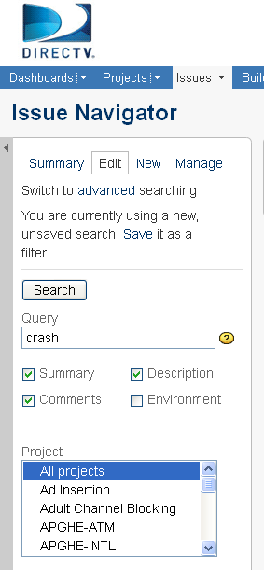
Searching issues – Simple Search
JIRA has a powerful search capability in the simple mode. We can search for issues across projects, versions and components using a range of filter criteria.
How to perform a search:
On the top navigation bar, click the 'Issues' tab => the Issues Filter form is displayed on the left hand side of the screen.
Type your search term into the 'Query' box, and/or select other criteria from the drop-down boxes and check-boxes.
Click on the 'Search' button to perform the search => your search results will be displayed in the right hand side of the screen.

Slide 28
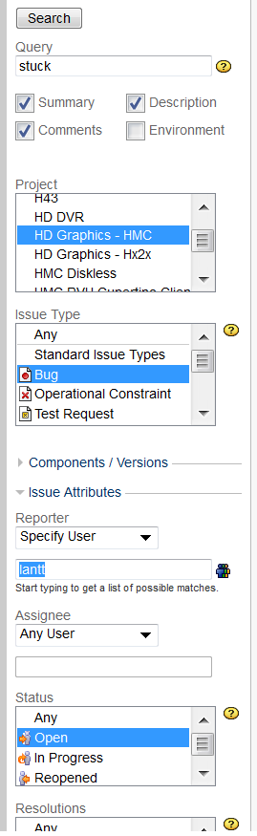
Simple search – example
Simple search example:
To search for all bugs opened by user “lantt”, in “HD Graphics – HMC” project, with “Open” status and contain “stuck” text in their Summary, Comments or Description, the filter should be:
Query string: stuck
Check the boxes: Summary, Comments, Description
Project: HD Graphics – HMC
Issue Type: Bug
Reporter: lantt
Status: Open
Click on the 'Search' button => the search results will be displayed in the right hand side of the screen.

Slide 29
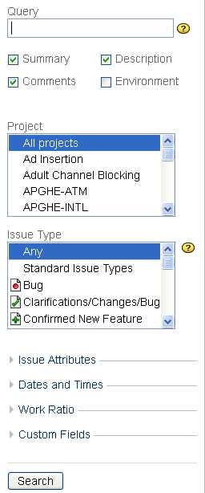
Simple search – criteria groups
In simple search mode, there are many criteria groups to narrow your search:
Simple filter with Query, Project, Issue Type criteria.
Issue Attributes: we can filter for Reporter, Assignee, Status, Resolutions, Priorities, Label.
Date and Times: we can filter for Created After, Created Before, Created, Updated After, Updated Before, Updated, Due After, Due Before, Due Date, Resolved After, Resolved Before, Resolved.
Work Ratio: we can filter for % done of issues (% Limits).
Custom Fields: we can filter for Assignee History, Date of First Response (after), Date of First Response (before), Date of First Response, Executive Visibility, Platform/s, Time in Status.

Slide 30
Searching issues
Quick Search
Simple Search
Advanced Search
Issue Filters

Slide 31
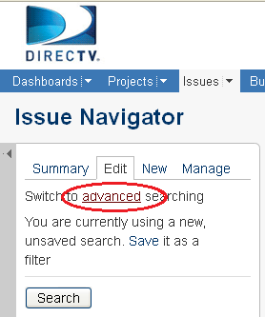

Searching issues – Advanced Search
An advanced search allows you to use structured queries to search for issues.
To perform an Advanced Search:
On the top navigation bar, click the "Issues" tab => This will display the Simple Search panel on the left hand side of the screen.
Click on "advanced“=> This will display the "Query" box.
Type your query using the fields, operators and field values/functions.
Click the "Search" button to run your query => The search results will be displayed below the query.

Slide 32
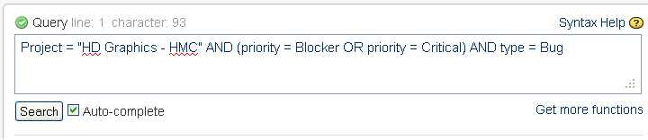
Advanced Search – Example
Example:
If you want to search for all bugs which belong to “HD Graphics – HMC” project and their priority are “Blocker” or “Critical”, type the following string into the query box:
Project = “HD Graphics – HMC” AND (priority = Blocker OR priority = Critical) AND type = Bug
Click "Search" button, and see the result

Slide 33
Advanced Search – keywords and syntax
Supported keywords, operators, fields, functions (refer to JIRA online help for a complete list)
Keywords: OR, AND, NOT, EMPTY, NULL, ORDER BY
Operators: =, !=, >, <, >=, <=, IN, NOT IN, ~ (contain), !~,…
Fields: assignee, created, category, project, priority, reporter, status, text, type, updated, description, watcher, resolution,…
Functions: membersOf(), currentUser(), currentLogin(), lastLogin(), startOfDay(), endOfDay(), startOfWeek(), endOfWeek(), startOfMonth(), endOfMonth(), releasedVersions(), unreleasedVersions(), latestReleasedVersion(), earliestUnreleasedVersion()…
JIRA supports Auto-complete function: As you type your query, JIRA will recognize the context and offer a list of "auto-complete" suggestions for you.
We can save the query for future use. We can also share the query with Group, Project or Everyone to utilize it.

Slide 34
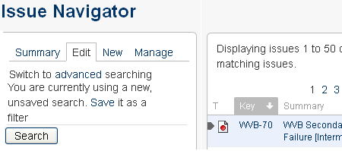
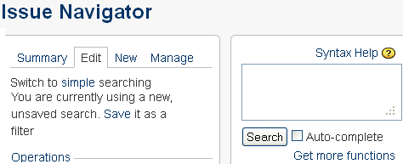
Switching between Advanced and Simple Search
On the top navigation bar, click the "Issues" tab. This will display the Search panel, this is also Simple Search page. On this, click "advanced". This will display the "Query" box of Advanced Search.
The same, on Advanced Search page, click on “simple” to switch back to Simple Search.
In general, a query created using 'Simple Search' will be able to be translated to 'Advanced Search‘, and back again. However, a query created using 'Advanced Search' may not be able to be translated to 'Simple Search‘, particular if the query contains one of below operator: OR, NOT, EMPTY, !=, IS, IS NOT, >, >=, <, <=, or the query specifies a field and value that is related to a project.

Slide 35
Searching issues
Quick Search
Simple Search
Advanced Search
Issue Filters

Slide 36

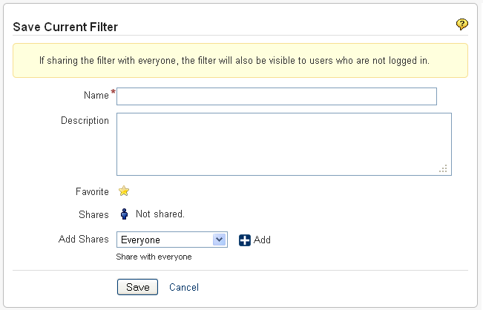
Issue Filters - Saving Searches
A saved search is called an 'issue filter'.
After doing your search, click the ‘Save it as a filter’ link in the left-hand column of the Issue Navigator.
Provide a name, description, favorite, share or not, then save your filter.

Slide 37
Issue Filters – Manage Filter
On the top navigation bar, click the 'Issues' dropdown and select 'Manage Filters' from the list.
The 'Manage Filters' page will display. From this page, you can perform the functions listed below:
Create a new search to be saved as a filter.
Add a filter as a favorite.
Share a filter that you have created with other users.
Search for filters that has been created by you or shared with you by other users.
Update an existing filter's details or edit a filter's search criteria for a filter that you have created.

Slide 38
Overview
Access to JIRA
Create a new issue
Searching for issues and issue filter.
Watching an issue
JIRA Dashboard
DAMS Viewer and logs attaching

Slide 39
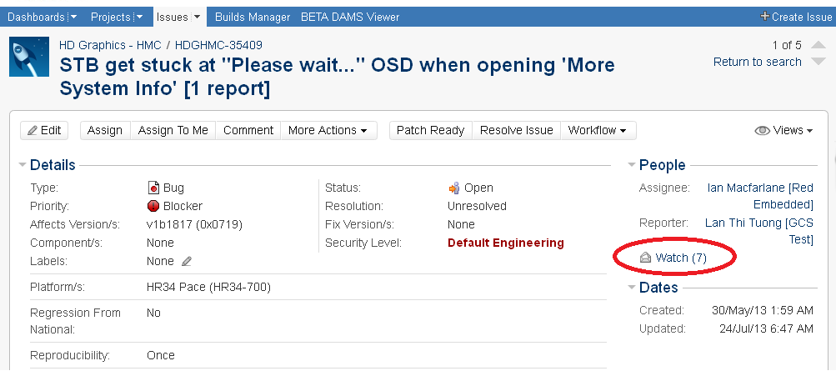
Watching Issues
JIRA allows users to watch for a particular issue, all watchers will be notified by email for any updates or comments on that issue.
Click on the “Watch” icon to become a watcher of the issue.
Click on the “Watch” icon again to stop watching the issue.

Slide 40
Overview
Access to JIRA.
Creating new issue on different issue types, actions required when there is update on issue and assigning issue.
Searching issues and issues filter.
Watching an issue.
Dashboard, DAMS Viewer, and logs attaching.

Slide 41
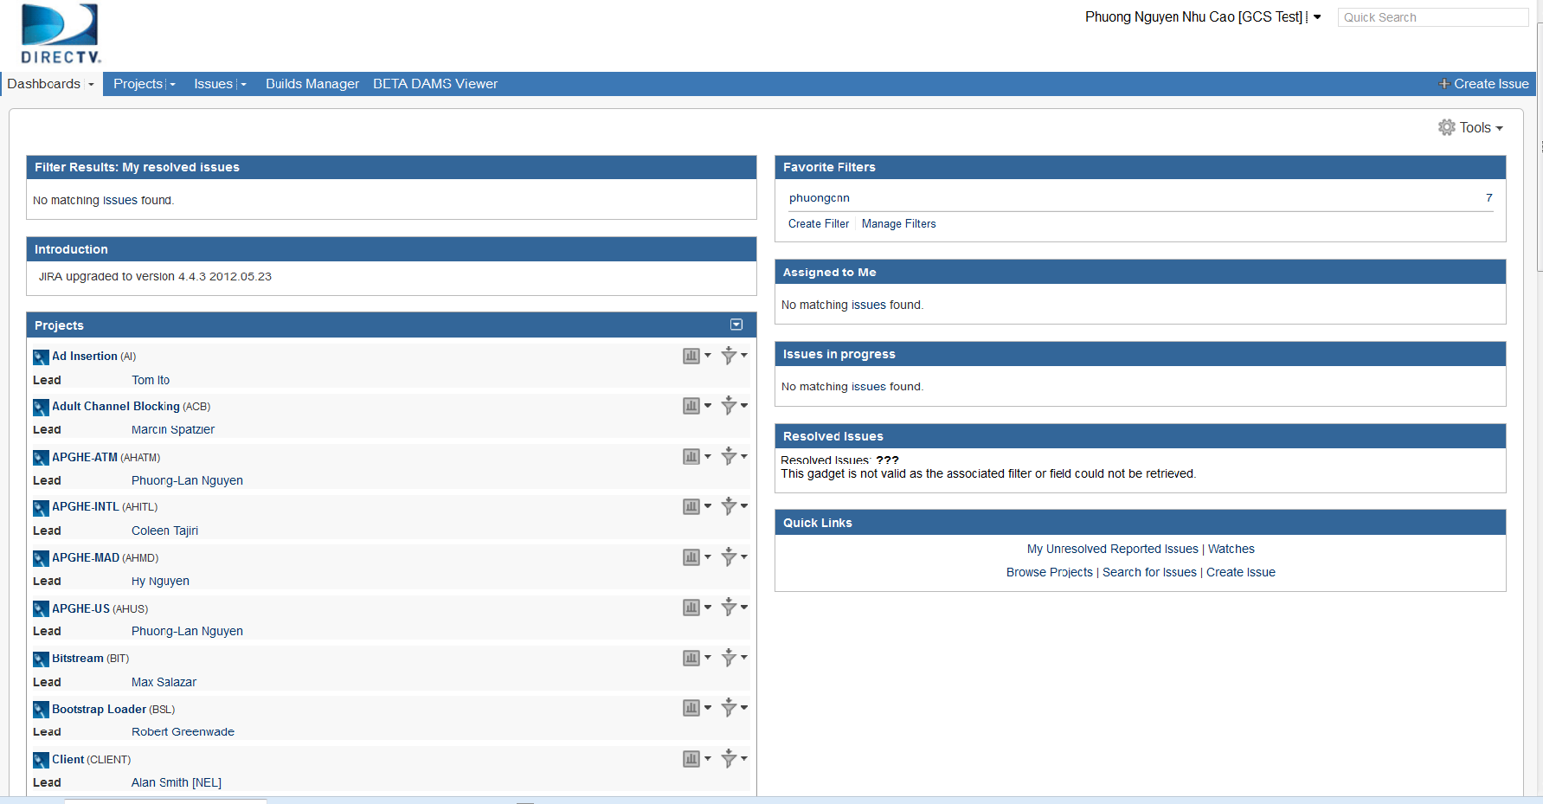
Dashboard
JIRA Dashboards is the first screen you see after you log into JIRA.
It can be configured to display many different types of information, depending on each user’s interest.
If you have not created any dashboard, you will see the system dashboard as below.
The information boxes on the dashboard are called Gadgets.
Notes:
The JIRA Dashboards is the first screen you see when you log in to JIRA.
It can be configured to display many different types of information, depending on your areas of interest.
The information boxes on the dashboard are called Gadgets

Slide 42
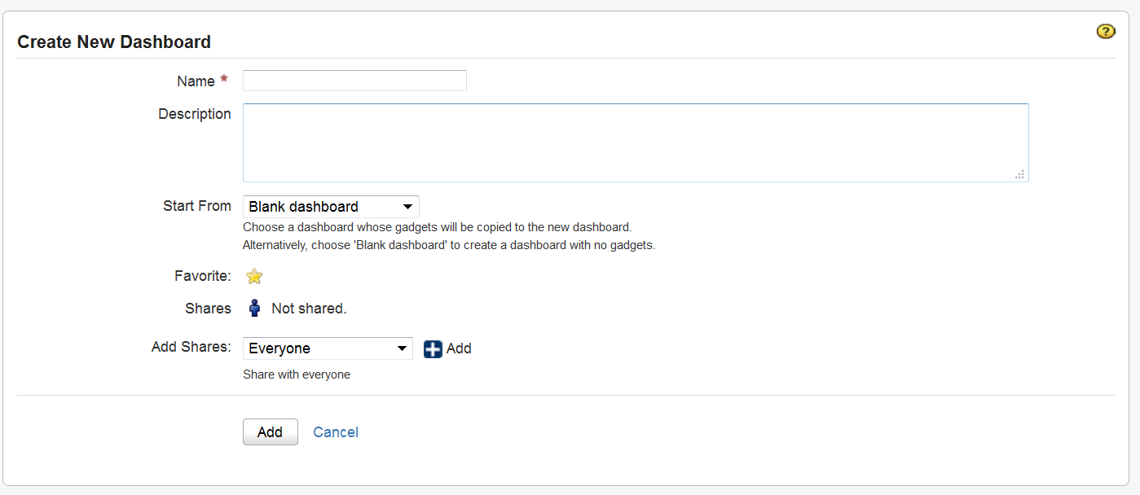
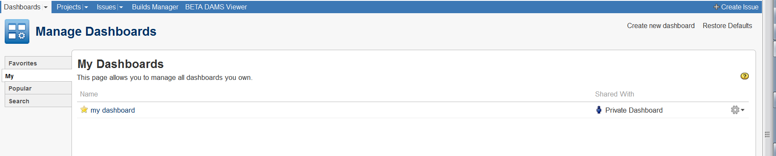
Dashboard – Create new dashboard
Create new dashboard from blank.
Notes:
Here I click on “Create New Dashboard”
I name the Dashboard “my first dashboard”->Start From Blank dashboard ->Select Favorite->Shares : Not shared so only I can see and use this dashboard.
Then click Add.
Now select the “blank dashboard” I just created.

Slide 43
Dashboard – Customize Dashboard
You can easily customize your dashboard by
Add more gadgets
Drag and drop to reposition the gadgets
Change the look of individual gadgets
Choosing a different layout
You can also
Create more pages for your dashboard
Share your pages with other people
Choose your favorites pages

Slide 44
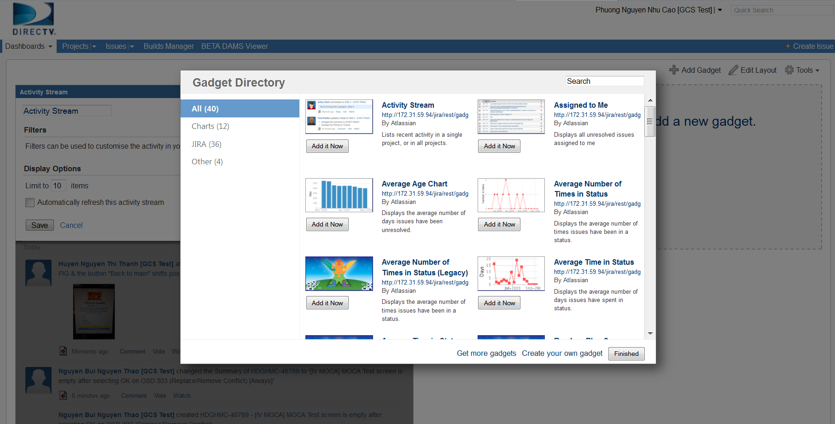
Dashboard customization – add gadgets
Add gadgets to dashboard.
Notes:
Click on “add new gadget”
Then select the “Gadget You can easily customize your dashboard by choosing a different layout, adding more gadgets, dragging the gadgets into different positions, and changing the look of individual gadgets.

Slide 45
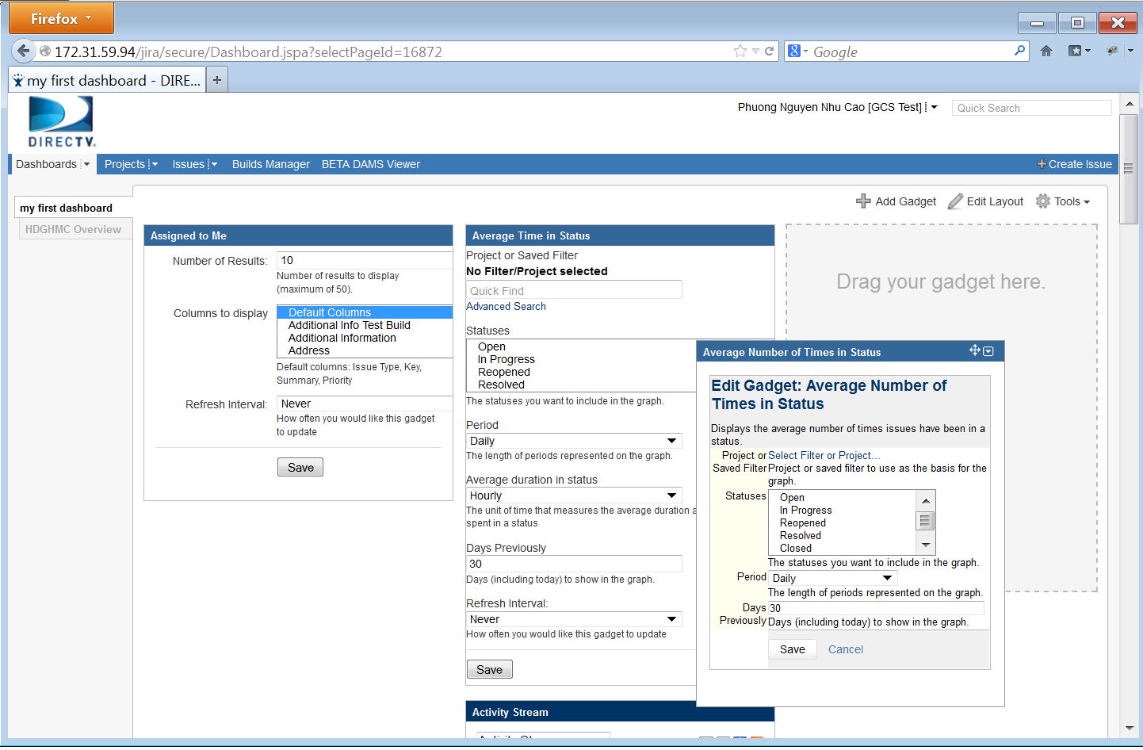
Dashboard customization – drag and drop
Click on the header of each gadget
Drag it to the desired location to reposition

Slide 46
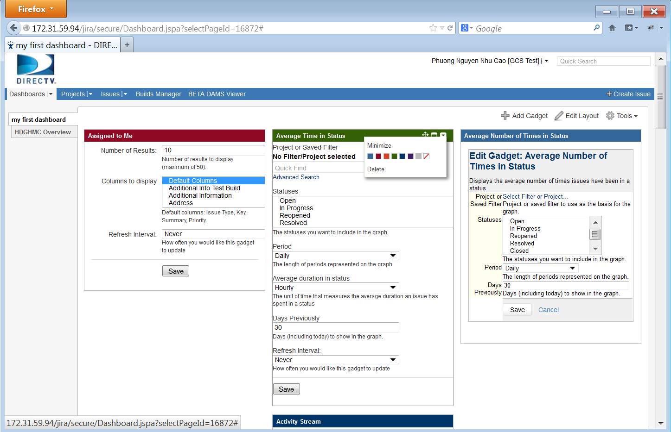
Dashboard customization – change gadget style
You can change the individual look of a gadget by clicking the dropdown icon from gadget header, then choose desired color

Slide 47
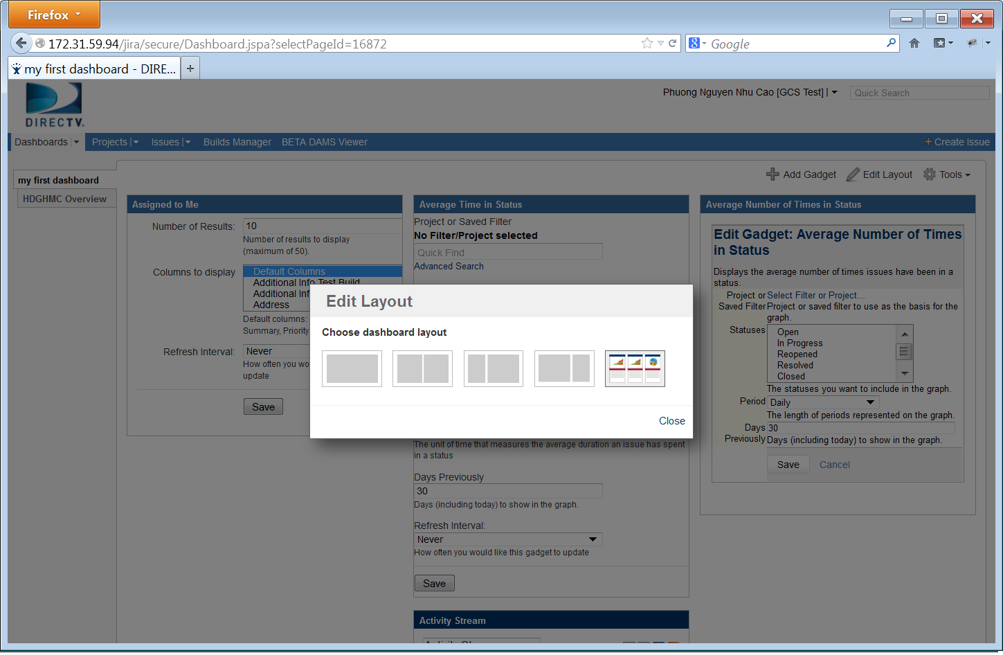
Dashboard customization - layout
You can easily customize your dashboard by choosing a different layout
Click "Edit Layout", then choose the layout you want

Slide 48
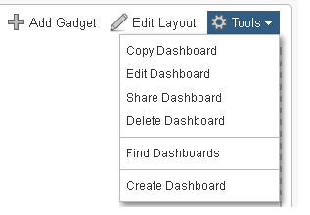
Dashboard – Customize Dashboard
Copy Dashboard
Edit Dashboard
Share Dashboard
Delete Dashboard
Find Dashboard
Create Dashboard

Slide 49
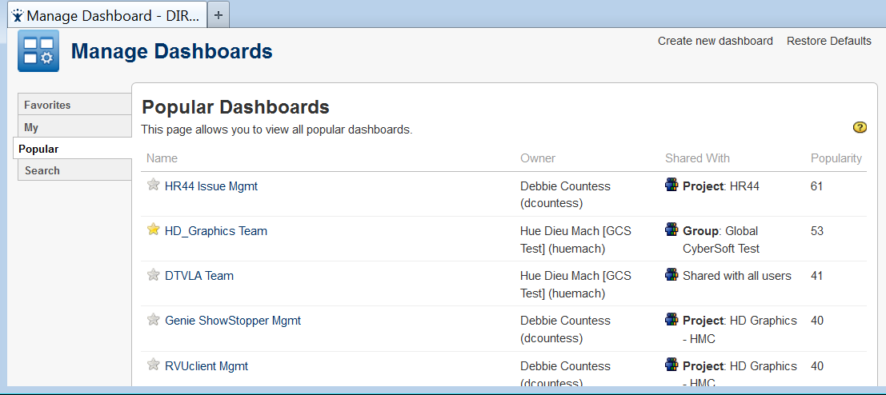
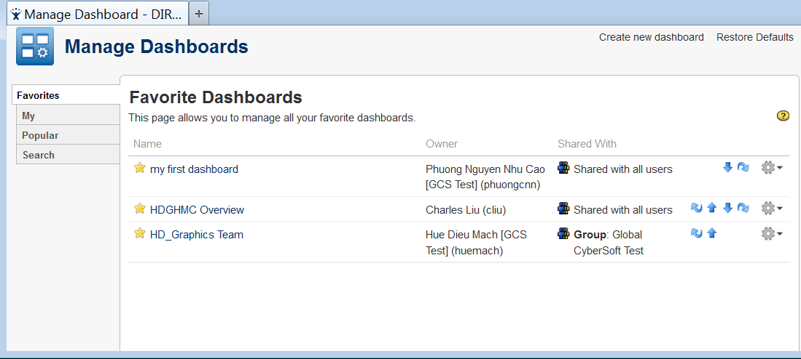
Dashboard – Customize Dashboard (cont.)
You can add pages to your favorite.

Slide 50
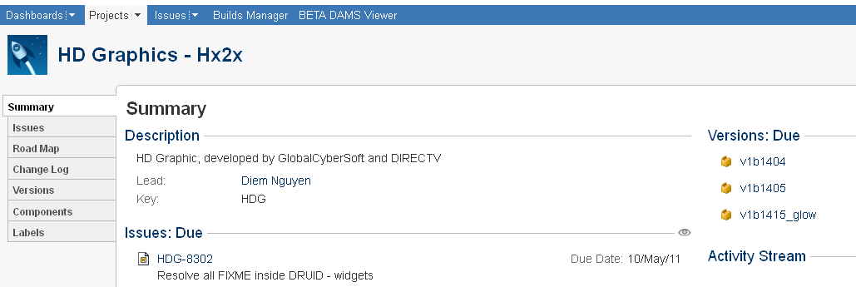
Browsing a Project
The project browser screen: provides a general overview of your project, with a variety of easily accessible reports for your project's issues, builds and source code reviews, from which you can 'dig down' into further detail.

Slide 51
Browsing a Project – Project Information
Choosing a project, then you can browse the following:
Summary: Shows recent activity in your project
Issues: Shows a summary of all issues in a project grouped by Status
Road Map: Shows unresolved issues for upcoming versions of a project.
Change Log: Shows resolved issues for previous versions of a project.
Versions: Shows a summary of recent versions for a given project.
Components: Shows a summary of all components for a given project.
Labels: shows all the most popular labels and its associated content.

Slide 52
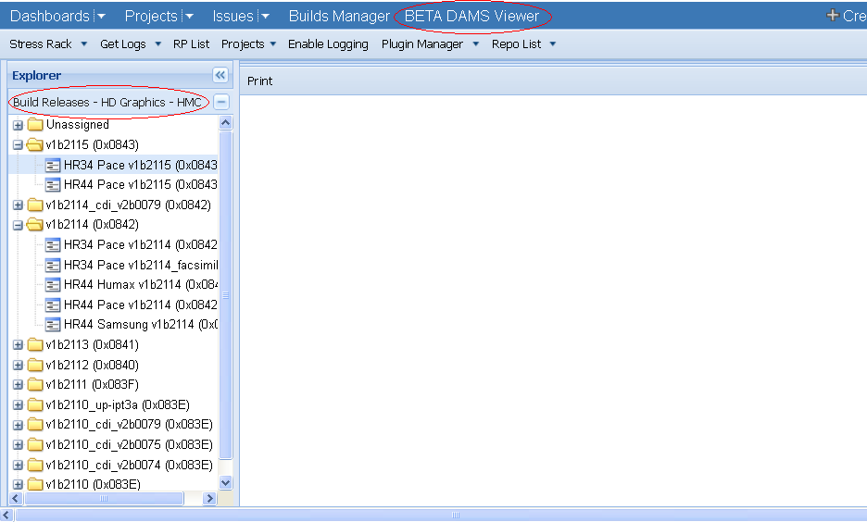
DAMS Viewer
DAMS Viewer provides users some useful facilities to learn about projects such as their releases and fixes, comparing the fixes between releases, attaching logs to an issue, RP List, Plug-in Manager,…
To open the DAMS Viewer: On the top navigation bar, click the ‘BETA DAMS Viewer' tab => the DAMS Viewer is opened with the current project’s releases listed on the left panel.

Slide 53
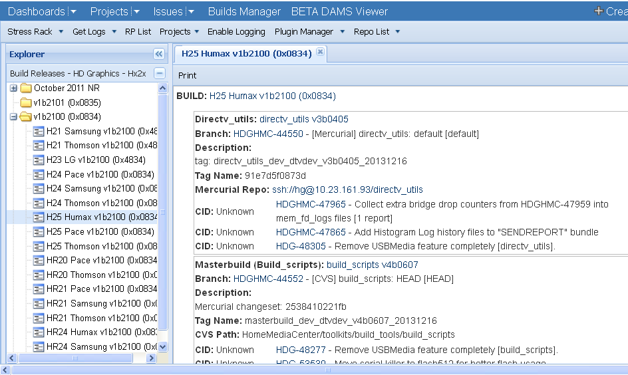
DAMS Viewer – Detail of a release
To change project: click on the “Projects” drop down list arrow, then select your desired project => The releases list is updated accordingly to the new project.
To view details information of a release, double click on the release => the fixes in detail of the release are displayed on the right panel.

Slide 54
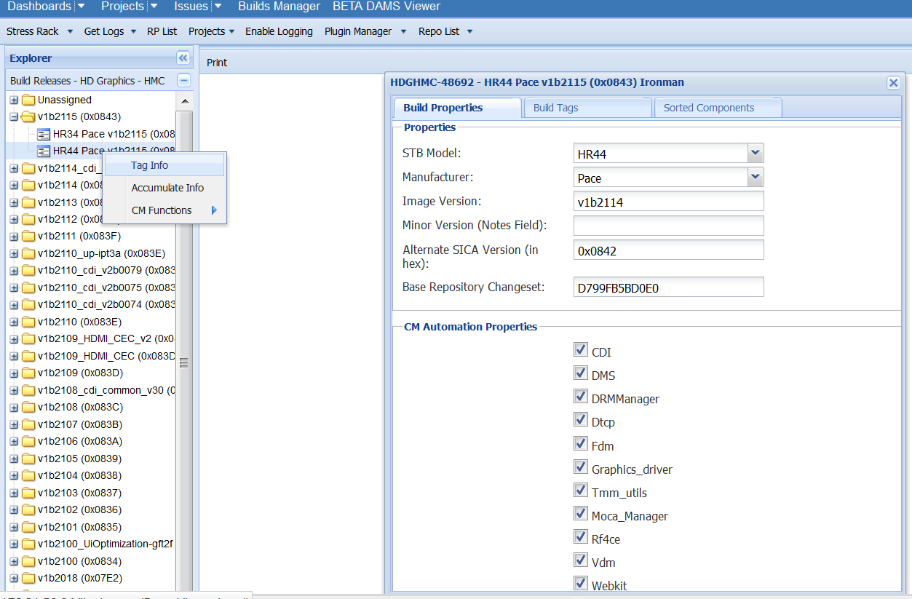
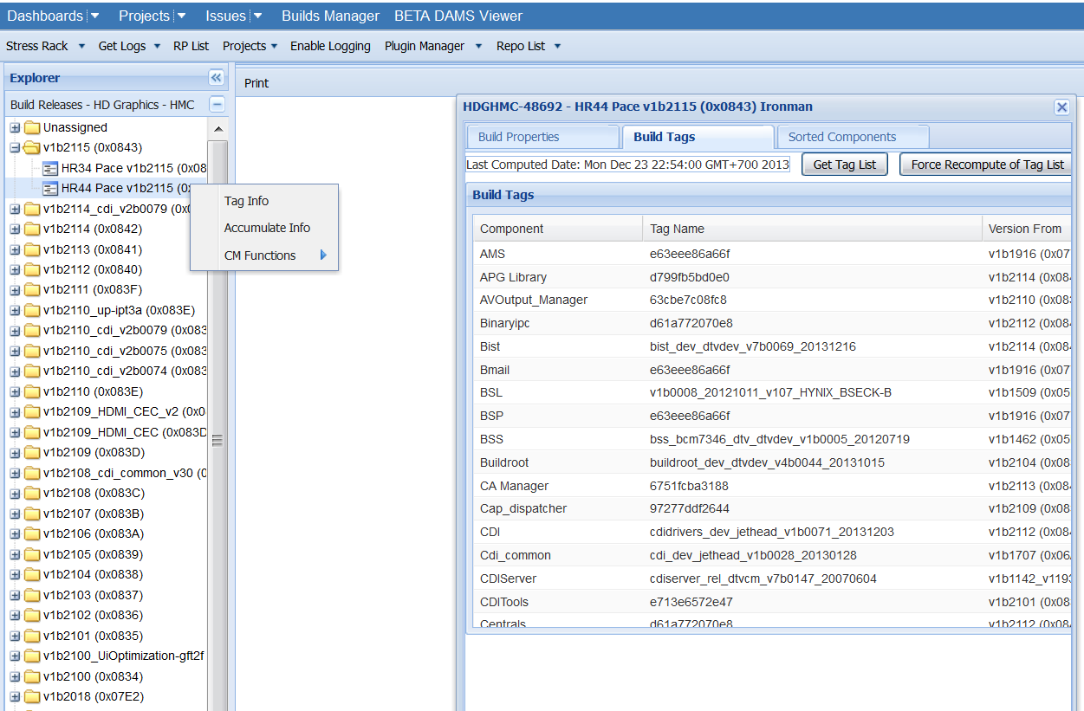
DAMS Viewer – View tags of a Release
To manage tags of a Build Release ticket, right click on a build, select Tag info, select Build Tags tab, and click on “Get Tag List” => List of all tags belong to the Build is displayed.
If the tags of the release have been updated, select “Force Recompute of Tag List”.

Slide 55
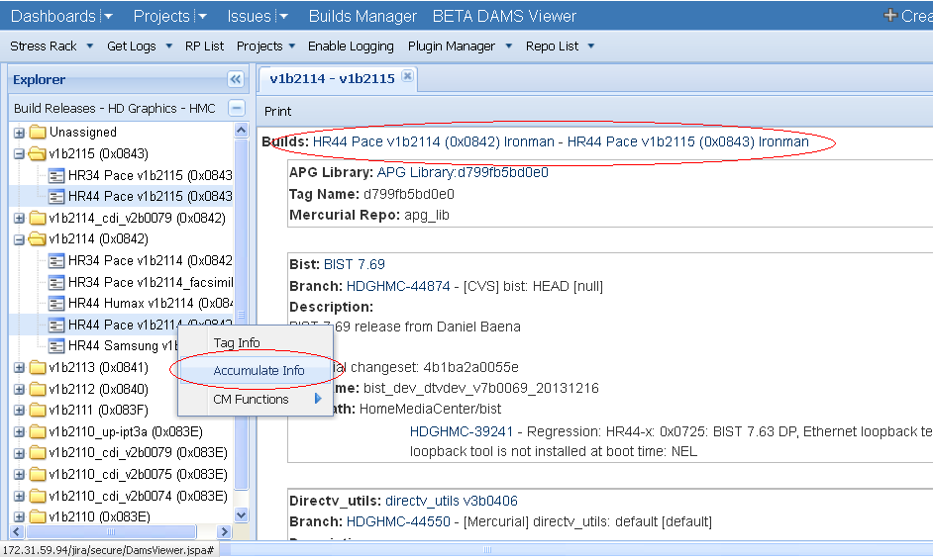
DAMS Viewer – Fixes between two releases
To compare the fixes between two releases: select 2 releases then right-click on one of them and then select “Accumulate Info” => the comparison results are displayed on the right hand side of the screen.

Slide 56
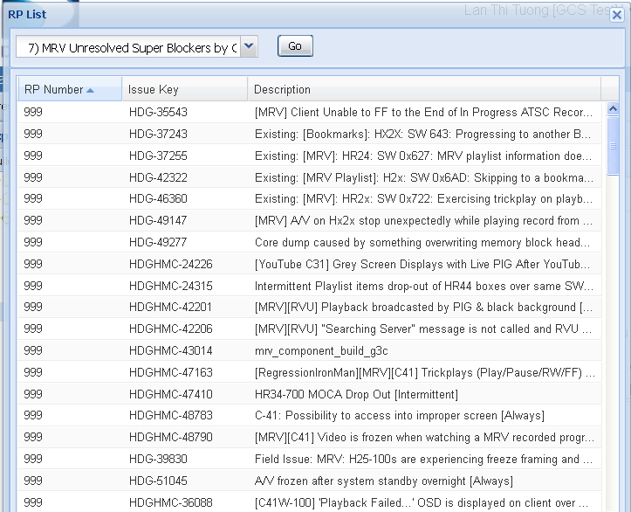
DAMS Viewer – RP List
JIRA provides a list of shared filters or queries for users to utilize them.
On the navigation bar, click the “RP List" => This will display the RP List screen with lots of shared filters/ queries.
Select a filter you want to execute then click on “Go“ button => This will display the filter results with the issues’ keys and descriptions.

Slide 57
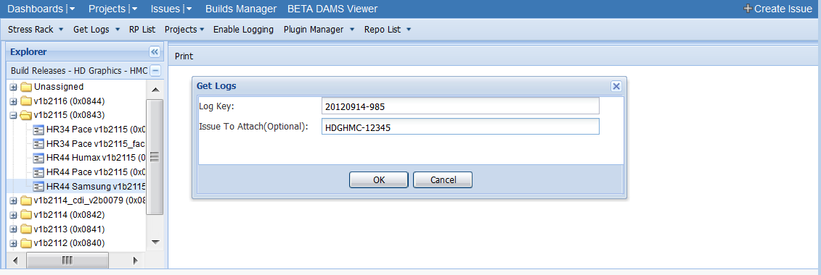
DAMS Viewer – Get Logs
We can attach logs from STB to an issue by using “Get Logs” facility.
To attach logs: click on “Get Logs”, then enter the “Log Key” that was created when getting logs from STB, and enter the “Issue To Attach” (the issue ID), then click on “OK” button => the logs will be attached to the issue in a while.

Slide 58
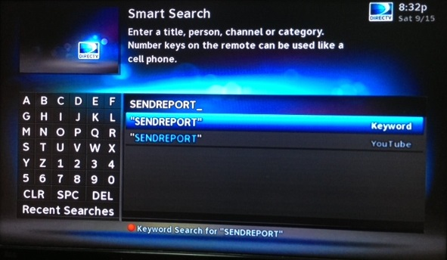
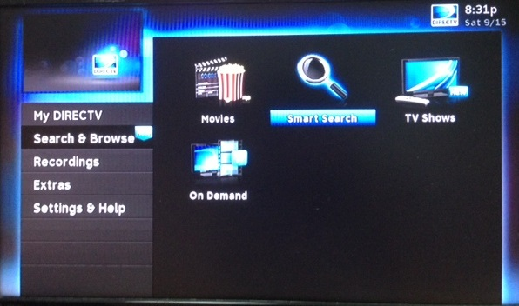
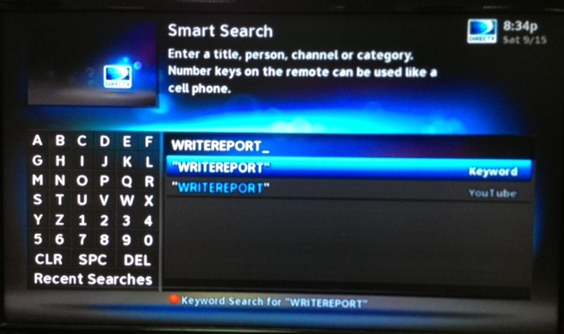
Attaching logs
When creating an issue, usually a Bug/Improvement, reporter must provide the log from STB. There are several ways to provide the logs:
Getter utility captures the logs and stores it on ftp server, then emails the link to logs to the tester.
Users with internet connection can use SENDREPORT search and users without internet connection can use WRITEREPORT to capture the STB logs on USB key.
The above keywords can be searched using Menu/Search & Browse/Smart Search

Slide 59
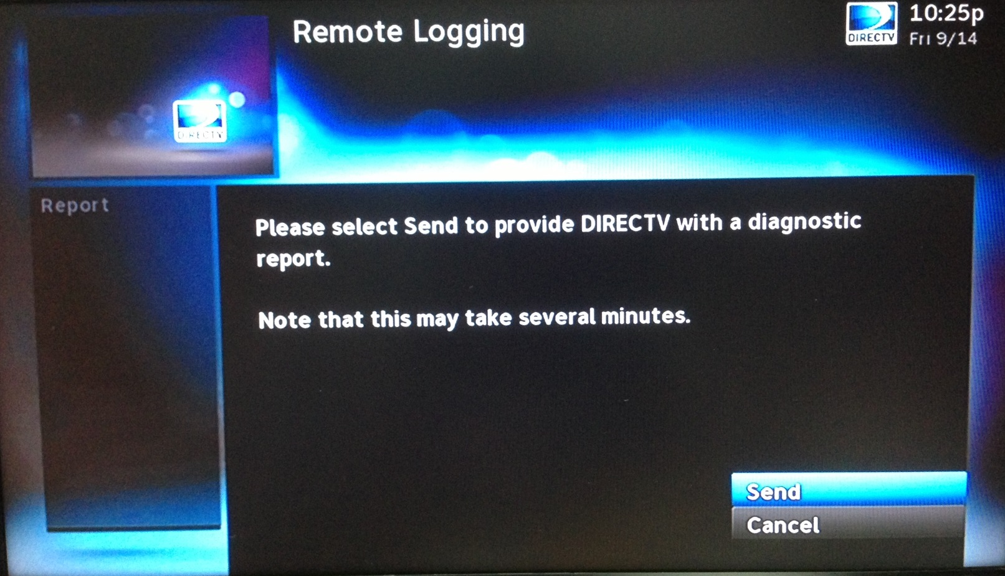
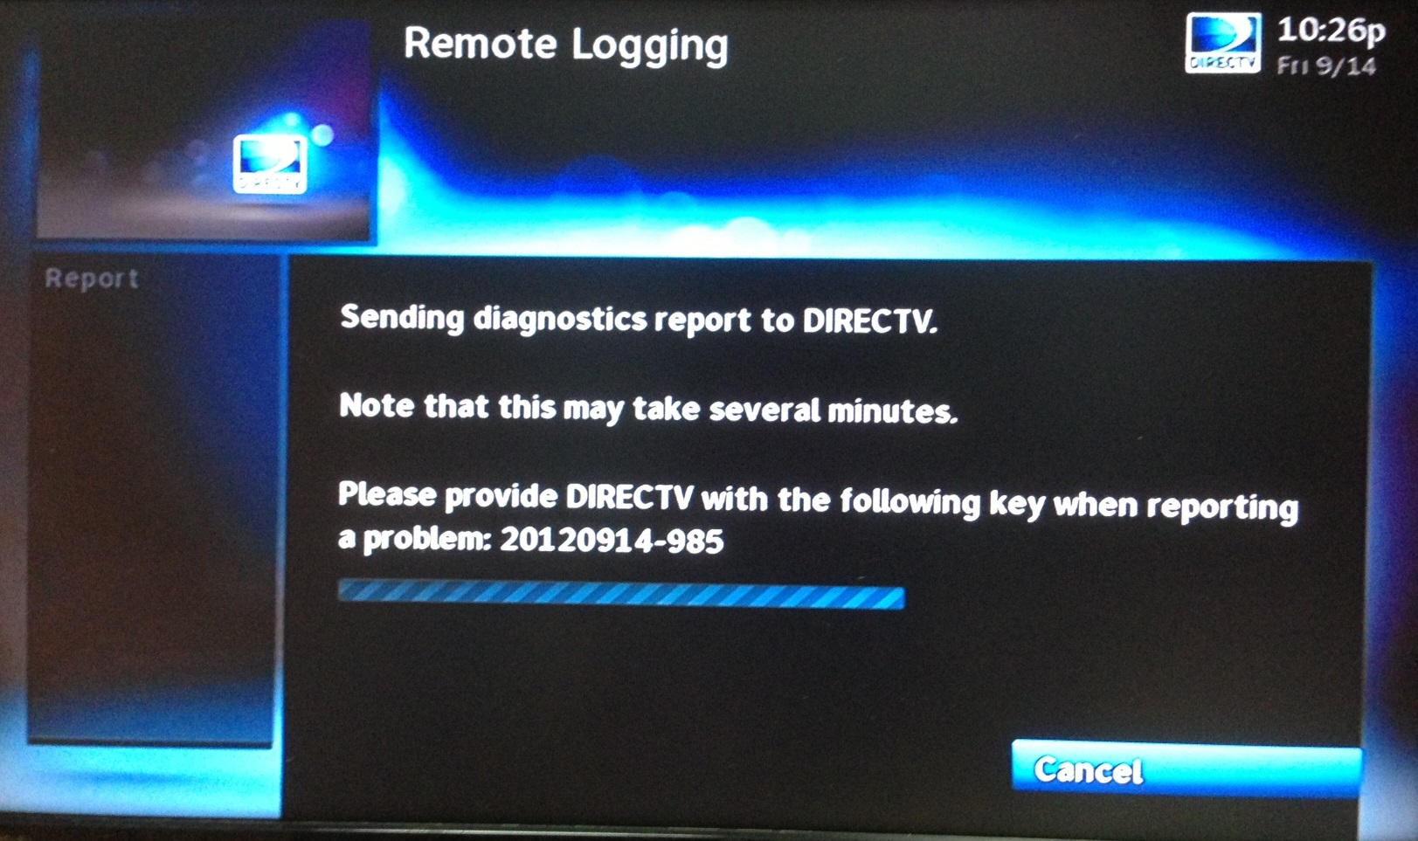
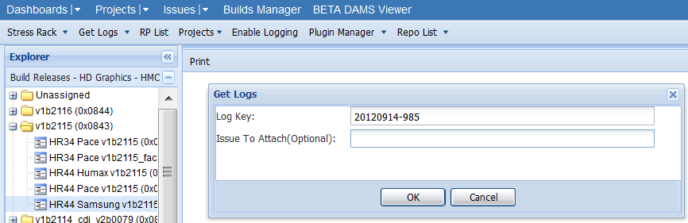
Attaching logs with SENDREPORT
The logs stored in STB will be sent to DIRECTV server when performing "SENDREPORT" in keyword search. A “Log key” will also be generated.
To attach the log to JIRA, you can use “Get Logs” in JIRA DAMS Viewer.

Slide 60
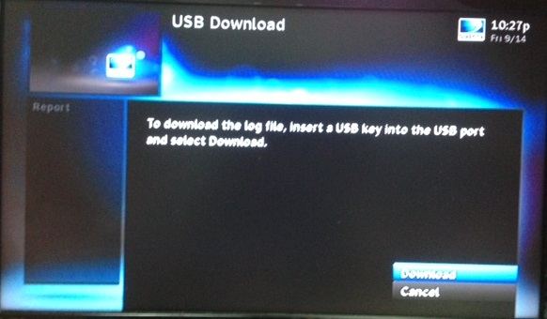
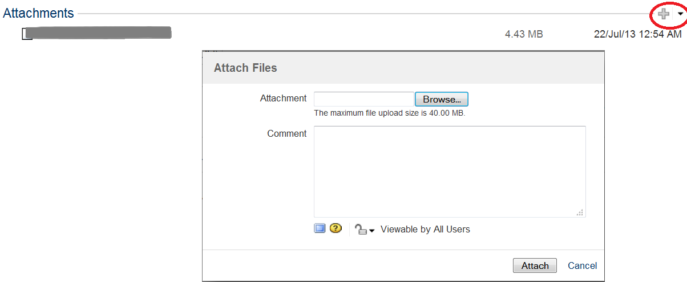
Attaching logs with WRITEREPORT
The SENDREPORT in keyword search requires internet connection from STB to DIRECTV server. What if we get problems with the connection?
We can download the log from STB to USB by performing WRITEREPORT in keyword search, then attach the log file to JIRA.

Slide 61
Thank you

